Slide 1
Marketing Proposal for Q2 2025
Prepared by MD. SHAWON
Date:14-01-20

Slide 2
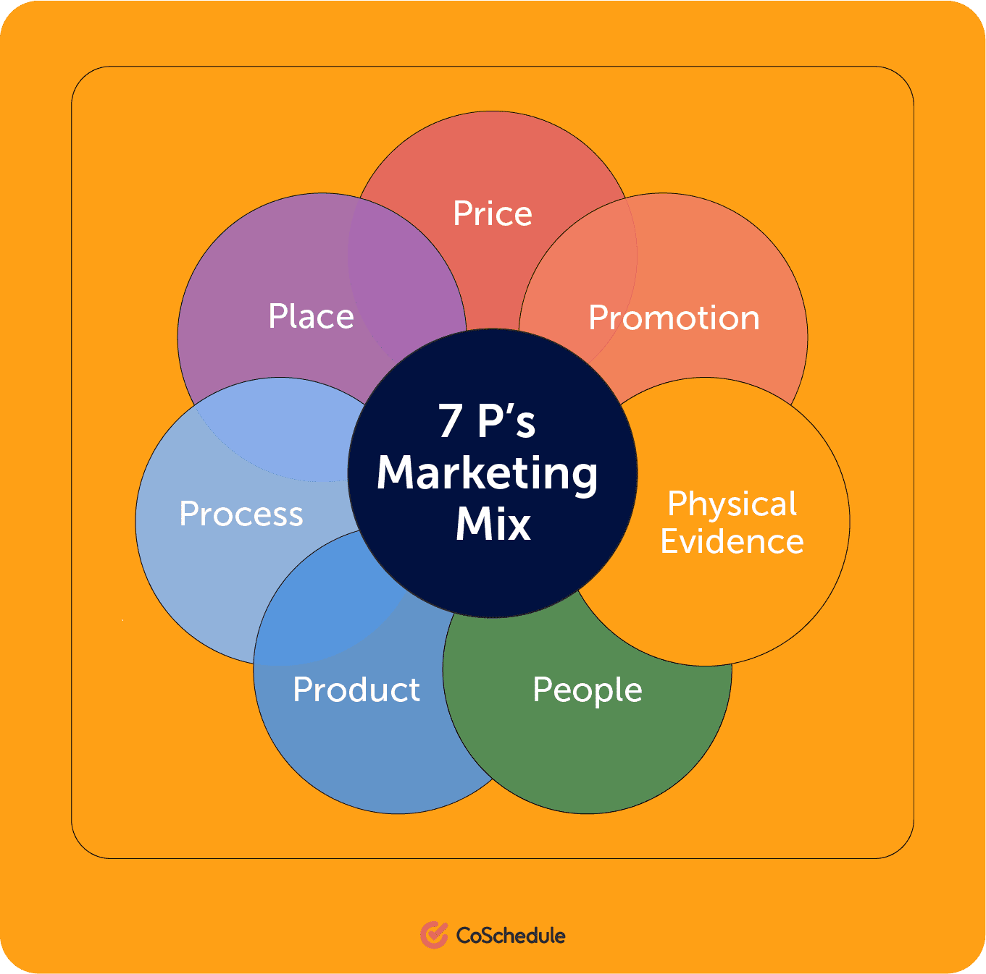
Marketing Principles.

